Slide 1
Data visualization
All samples available on:
http://github.com/a-vodka/dv

Slide 2
Realisation of the course
This course has been developed within the framework of the project “Mechanics digital" by the German Academic Exchange Service (DAAD) under funding program “Ukraine digital: Ensuring academic success in times of crisis (2022)" The course has been developed in collaboration with our colleagues from the Otto-von-Guericke-University Magdeburg in Germany We would like to thank the DAAD for their financial and logistical support

Slide 3
Vector Visualization
Dr. Jie Zhang materials is used

Slide 4
Outline
1. Divergence and Vorticity
2. Vector Glyphs
3. Vector Color Coding
4. Displacement Plots
5. Stream Objects
6. Texture-Based Vector Visualization

Slide 5
Vector Function

Slide 6
Vector vs Scalar

Slide 7
Example in 2-D

Slide 8
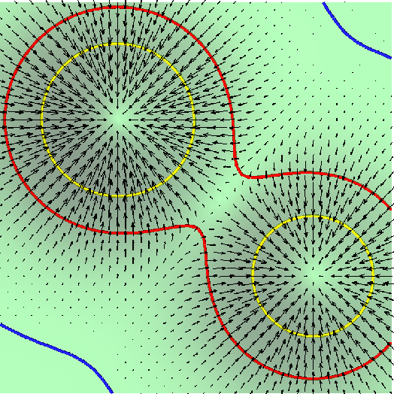
Gradient of a Scalar

Slide 9
Gradient of a Scalar

Slide 10
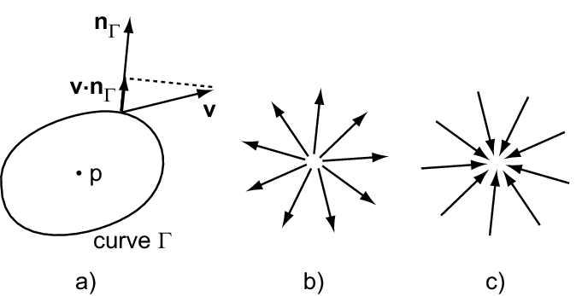
Divergence of a Vector

Slide 11
Divergence of a Vector
Divergence computes the flux that the vector field transports through the imaginary boundary Γ, as Γ→0
Divergence of a vector is a scalar
A positive divergence point is called source, because it indicates that mass would spread from the point (in fluid flow)
A negative divergence point is called sink, because it indicates that mass would get sucked into the point (in fluid flow)
A zero divergence denotes that mass is transported without compression or expansion.

Slide 12
Divergence of a Vector

Slide 13
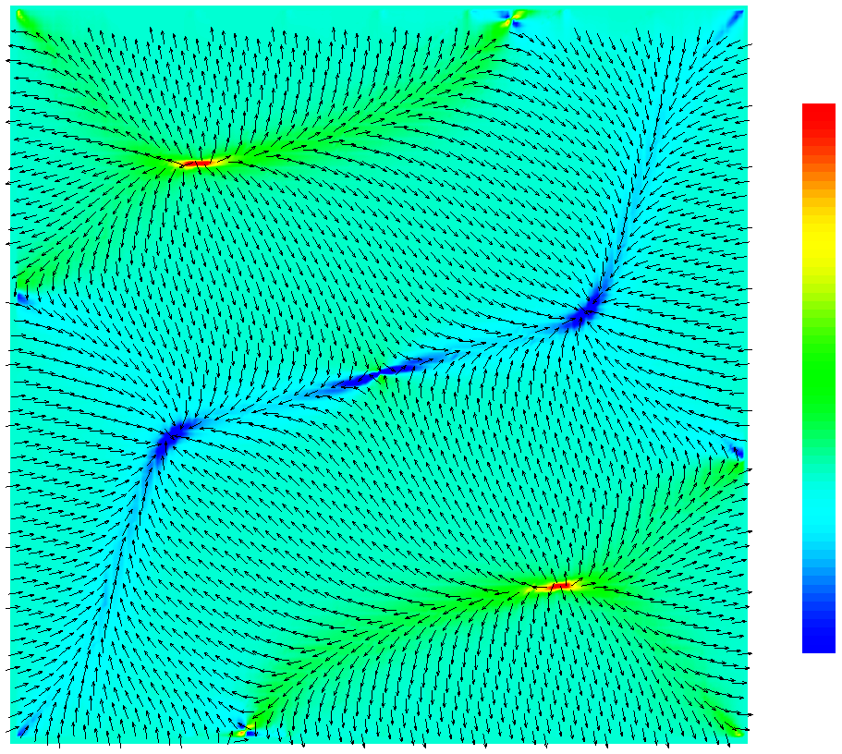
Divergence of a Vector

Slide 14
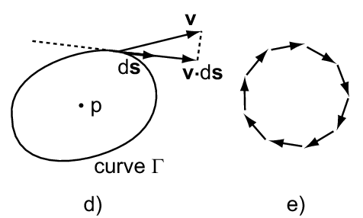
Vorticity of a Vector

Slide 15
Vorticity of a Vector
Vorticity computes the rotation flux around a point
Vorticity of a vector is a vector
The magnitude of vorticity expresses the speed of angular rotation
The direction of vorticity indicates direction perpendicular to the plane of rotation
Vorticity signals the presence of vortices in vector field

Slide 16
Vorticity of a Vector
Notes:
Ask a student to draw the vectors on the white board

Slide 17
Vorticity of a Vector
Notes:
Ask a student to draw the vectors on the white board

Slide 18
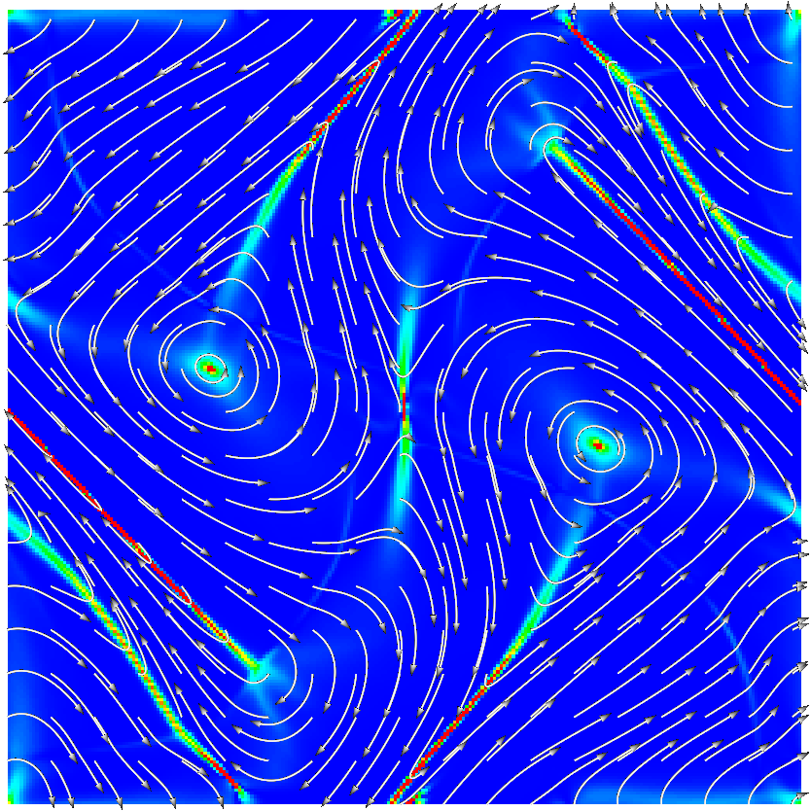
Vorticity of a Vector
Color: +
Glyph: +

Slide 19
Vector Glyph
Vector glyph mapping technique associates a vector glyph (or icon) with the sampling points of the vector dataset
The magnitude and direction of the vector attribute is indicated by the various properties of the glyph: location, direction, orientation, size and color

Slide 20
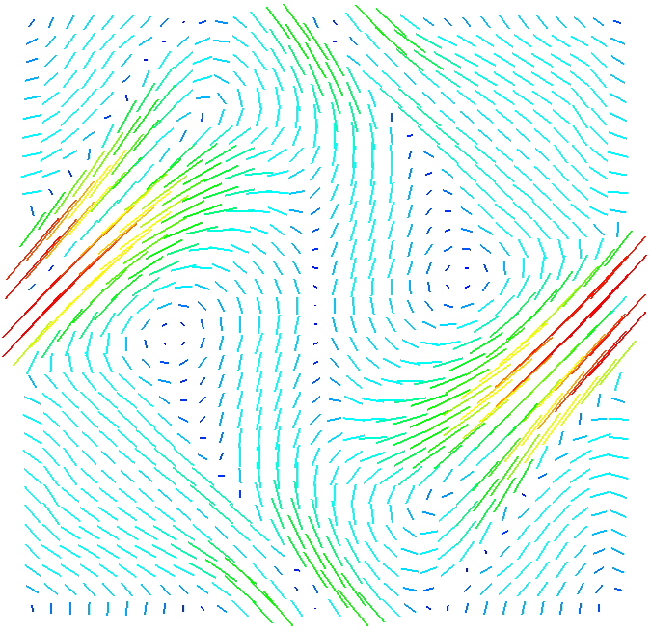
Vector Glyph
Line glyph,
or hedgehog glyph
Sub-sampled by
a factor of 8
(32 X 32)
Original (256 X 256)
Velocity Field of a 2D Magnetohydrodynamic Simulation
Notes:
Sub-sampling: change the sampling size of the dimensions
Over-sampling

Slide 21
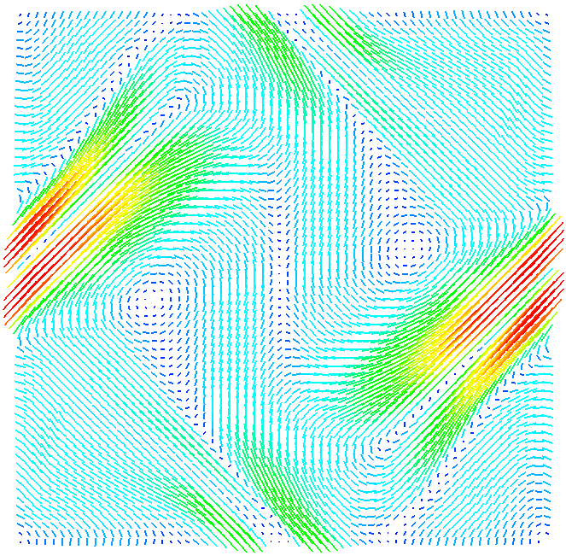
Vector Glyph
Line glyph,
or hedgehog glyph
Sub-sampled by
a factor of 4
(64 X 64)
Original (256 X 256)
Velocity Field of a 2D Magnetohydrodynamic Simulation

Slide 22
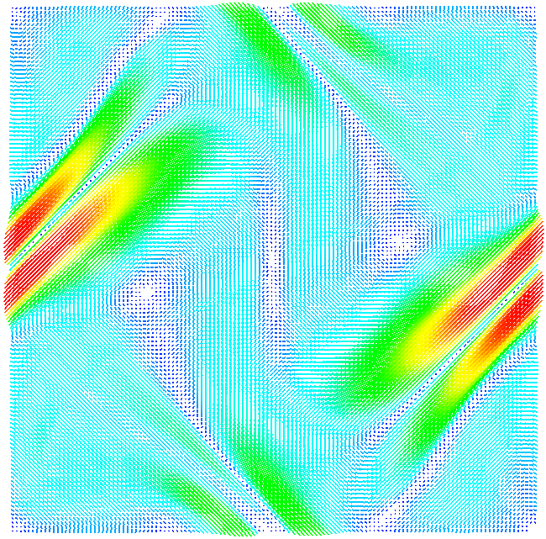
Vector Glyph
Sub-sampled by
a factor of 2
(128 X 128)
Original (256 X 256)
Problem with a dense
Representation using
glyph:
(1) Clutter (безлад)
(2) miss-representation
Notes:
Too much sampling, overlapping, and thus cause visual clutter

Slide 23
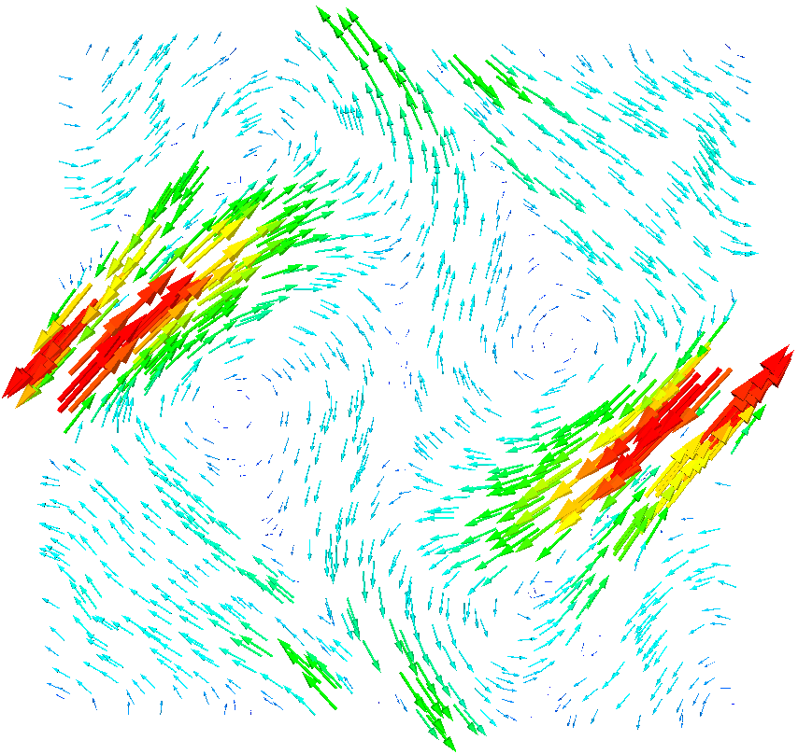
Vector Glyph
Random
Sub-sampling
Is better
Notes:
Show orientation (up or down, left or right)
Strong flow, and weak flow

Slide 24
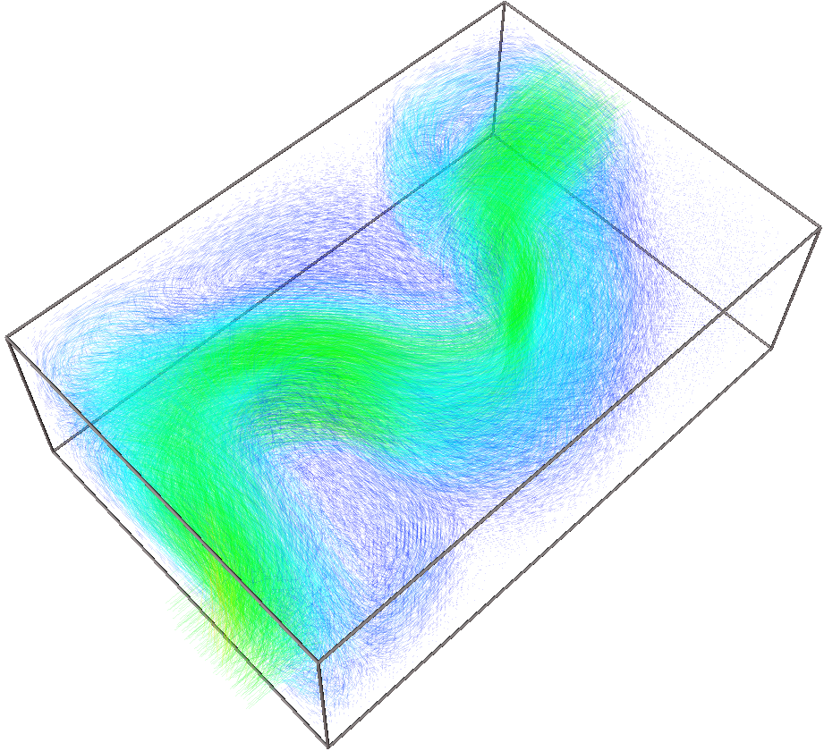
Vector Glyph: 3D
Simulation box: 128 X 85 X 42; or 456,960 data point
100,000 glyphs
Problem: visual occlusion
Notes:
Show orientation (up or down, left or right)
Strong flow, and weak flow

Slide 25
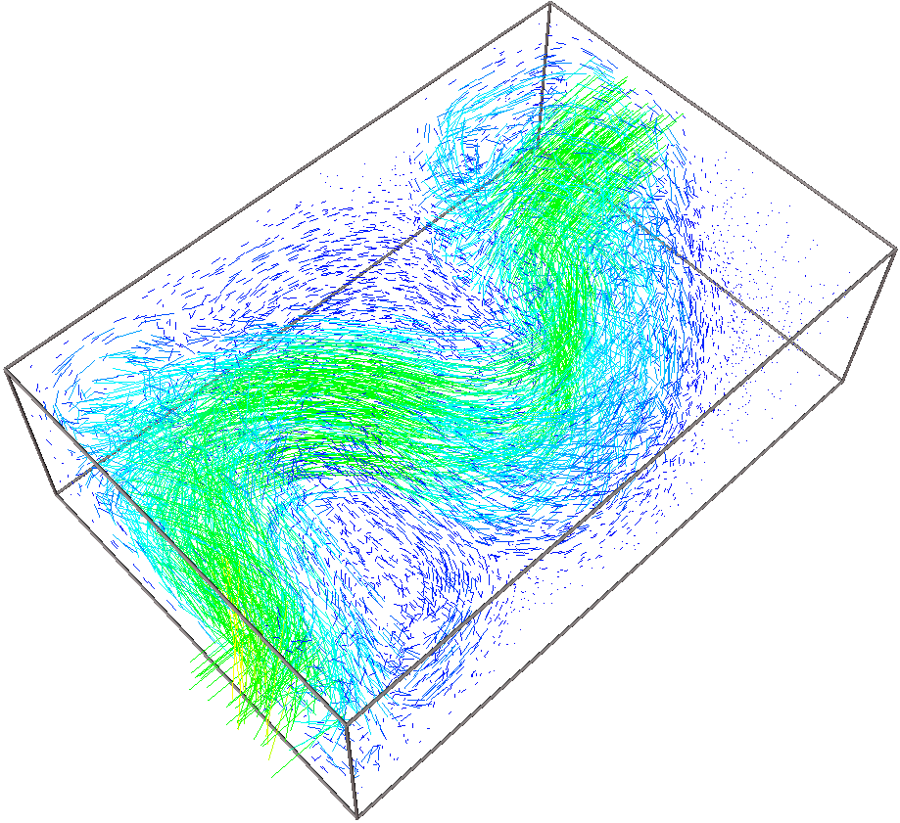
Vector Glyph: 3D
Simulation box: 128 X 85 X 42; or 456,960 data point
10,000 glyphs: less occlusion
Notes:
Show orientation (up or down, left or right)
Strong flow, and weak flow

Slide 26
Vector Glyph: 3D
Simulation box: 128 X 85 X 42; or 456,960 data point
100,000 glyphs, 0.15 transparency: less occlusion
Notes:
Show orientation (up or down, left or right)
Strong flow, and weak flow

Slide 27
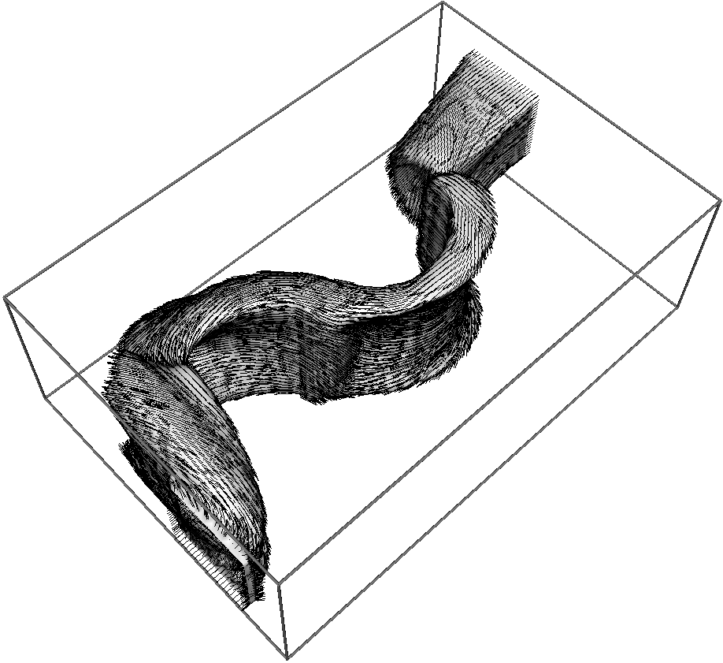
Vector Glyph: 3D
Simulation box: 128 X 85 X 42; or 456,960 data point
3D velocity isosurface
Notes:
Show orientation (up or down, left or right)
Strong flow, and weak flow

Slide 28
Vector Glyph
+ Glyph method is simple to implement, and intuitive to interpretation
+ High-resolution vector datasets must be sub-sampled in order to avoid overlapping of neighboring glyphs.
- Glyph method is a sparse visualization: does not represent all points
- Occlusion
- Subsampling artifacts: difficult to interpolate
Alternative: color mapping method is a dense visualization

Slide 29
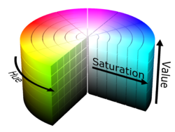
Vector Color Coding
Similar to scalar color mapping, vector color coding is to associate a color with every point in the data domain
Typically, use HSV system (color wheel)
Hue is used to encode the direction of the vector, e.g., angle arrangement in the color wheel
Value of the color vector is used to encode the magnitude of the vector
Saturation is set to one
HSV Color Model
Notes:
Color wheel: 6 primary color, 6 sector, 0, 60, 120, 180, 240, 300 degree

Slide 30
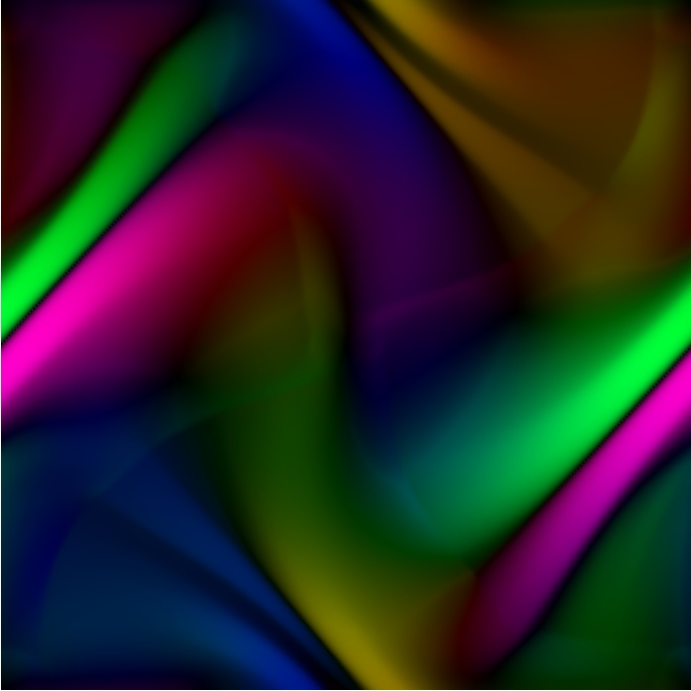
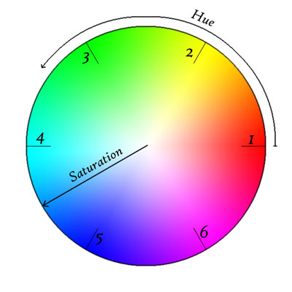
Vector Color Coding
2-D Velocity Field of the MHD simulation:
Orientation,
Magnitude
Notes:
MHD
CFD

Slide 31
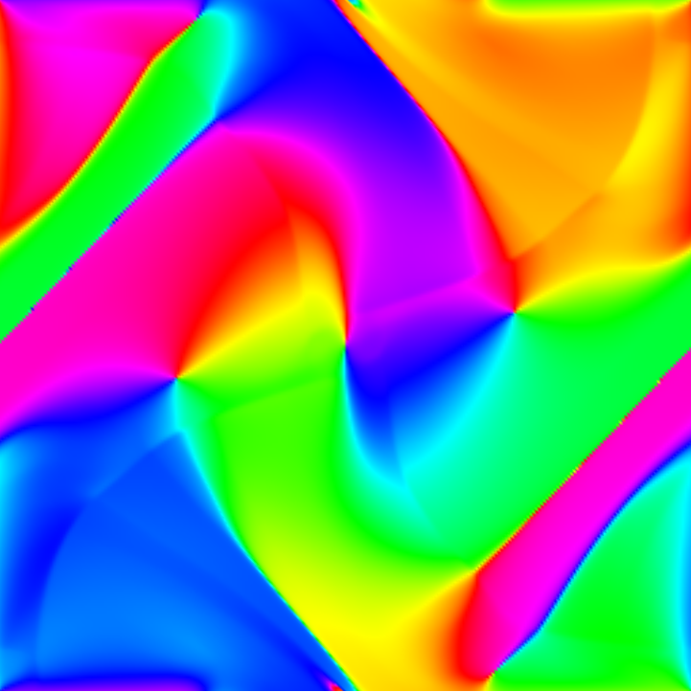
Vector Color Coding
2-D Velocity Field of the MHD simulation:
Orientation only; no magnitude
Notes:
MHD
CFD

Slide 32
Vector Color Coding
Dense visualization
Lacks of intuitive interpretation; take time to be trained to interpret the image

Slide 33
Stream Objects
Vector glyph plots show the trajectories over a short time of trace particles released in the vector fields
Stream objects show the trajectories for longer time intervals for a given vector field

Slide 34
Streamlines
Streamline is a curved path over a given time interval of a trace particle passing through a given start location or seed point

Slide 35
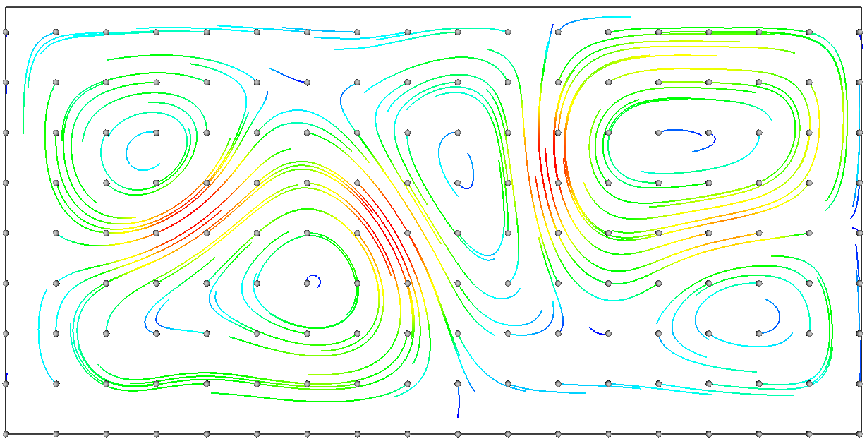
Streamlines
All lines are traced up to the same maximum time T
Seed points (gray ball) are uniformly sampled
Color is used to reinforce the vector magnitude
Notes:
Longer streamline for high speed stream
Shorter streamline for lower speed stream

Slide 36
Streamlines: Issues
Require numerical integration, which accumulates errors as the integration time increases
Euler integration: fast but less accurate
Runge-Kutta integration: slower but more accurate
Need to find optimal value of time step Δt
Choose number and location of seed points
Trace to maximum time or maximum length
Trace upstream or downstream
Saved as a polyline on an unstructured grid
Notes:
Contour lines find the edge points, and use linear basis function to interpret the intra-cell pixels

Slide 37
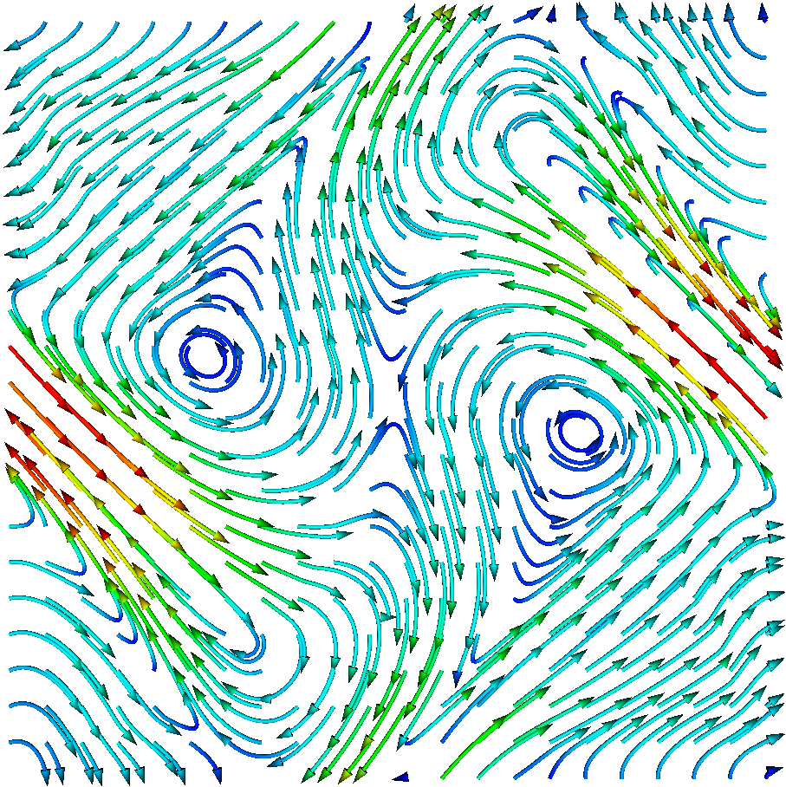
Stream tubes
Add a circular cross section along the streamline curves, making the lines thicker
Tracing downstream: the seed points are on a regular grid

Slide 38
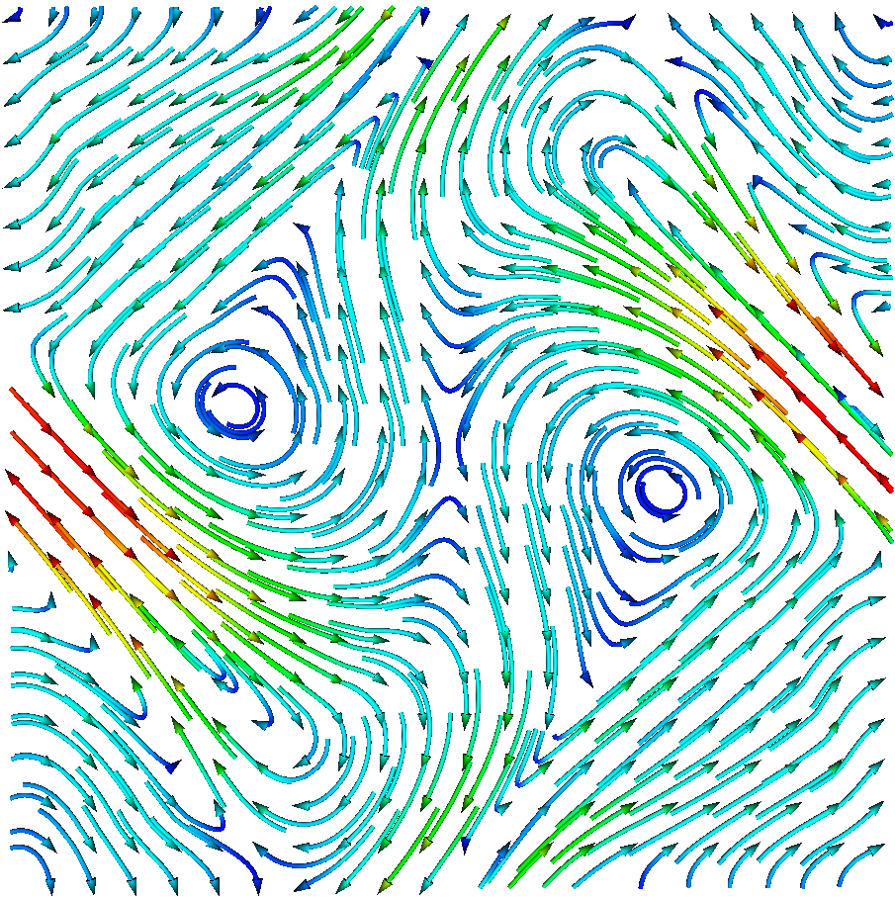
Stream tubes
Tracing upstream: the arrow heads are on a regular grid

Slide 39
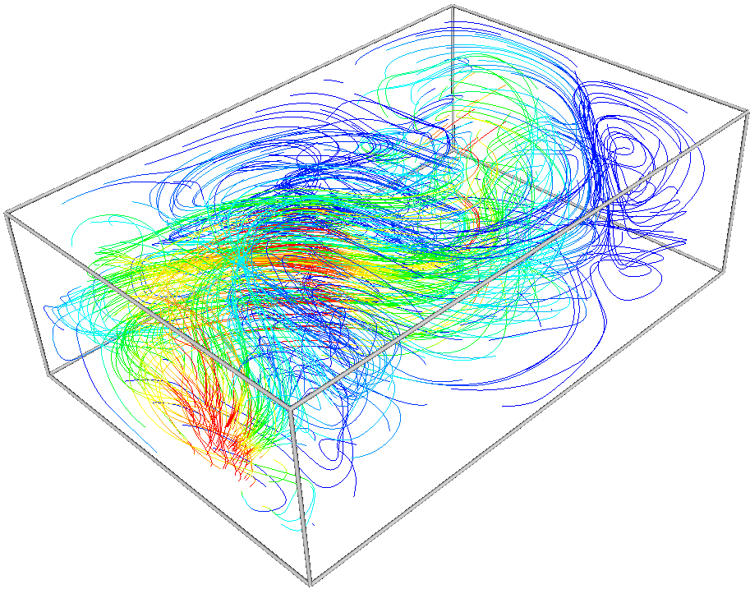
Stream Objects in 3-D
Input:
128 X 85 X 42
Undersampling:
10 X 10 X 10
Opacity 1
Maximum Length

Slide 40
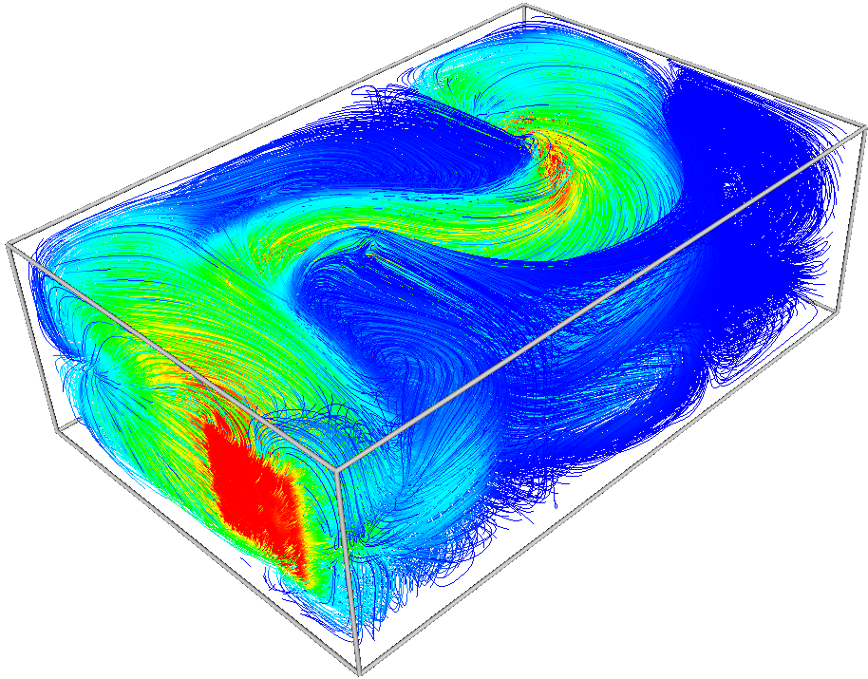
Stream Objects in 3-D
Input:
128 X 85 X 42
Undersampling:
3 X 3 X 3
Opacity 1
Maximum Length

Slide 41
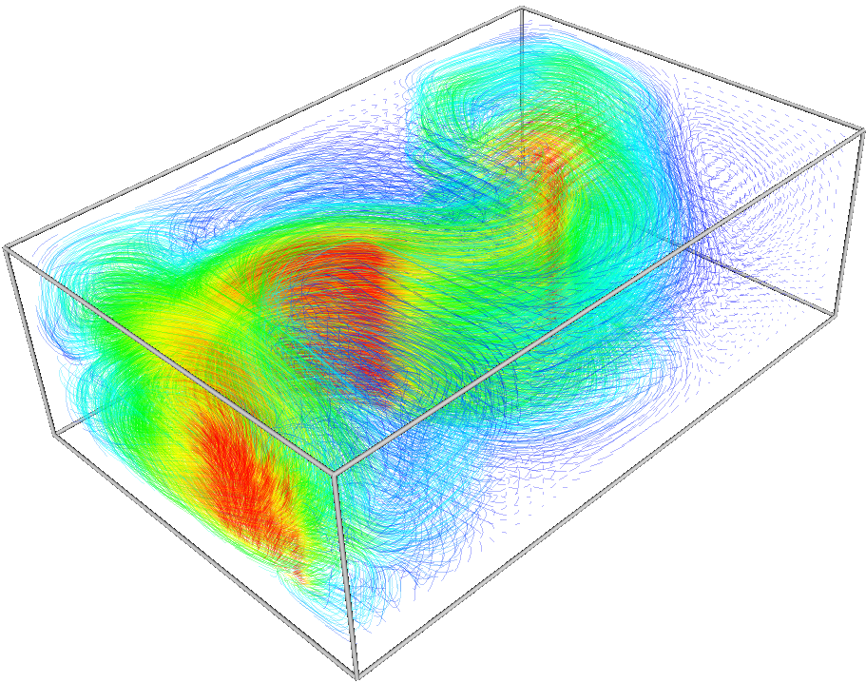
Stream Objects in 3-D
Input:
128 X 85 X 42
Undersampling:
3 X 3 X 3
Opacity 0.3
Maximum Time

Slide 42
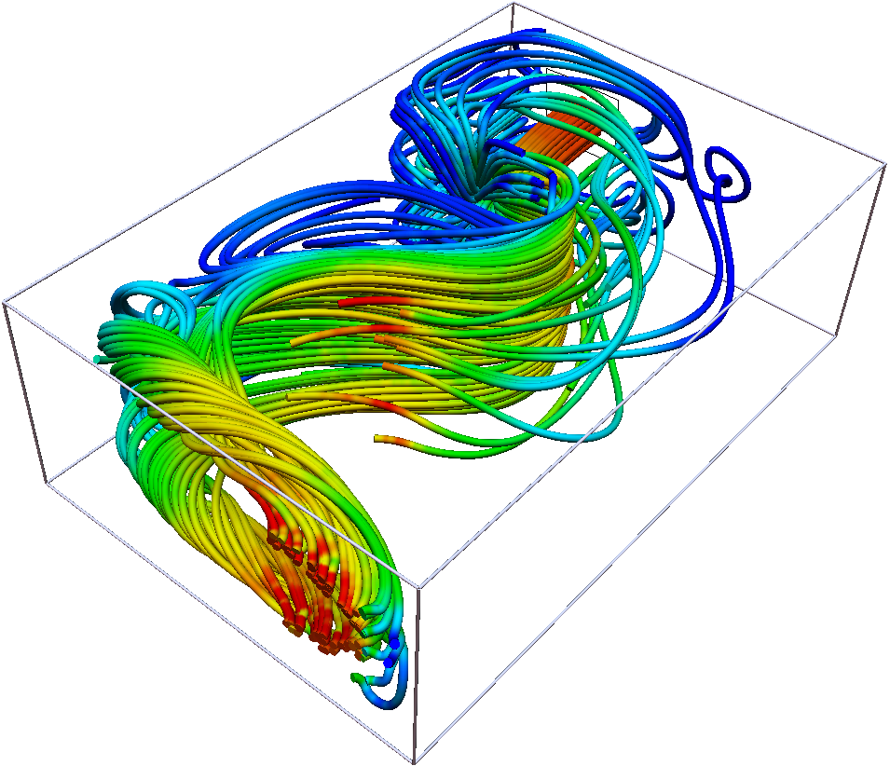
Stream Objects in 3-D
Stream tubes
Seed area at the flow inlet

Slide 43
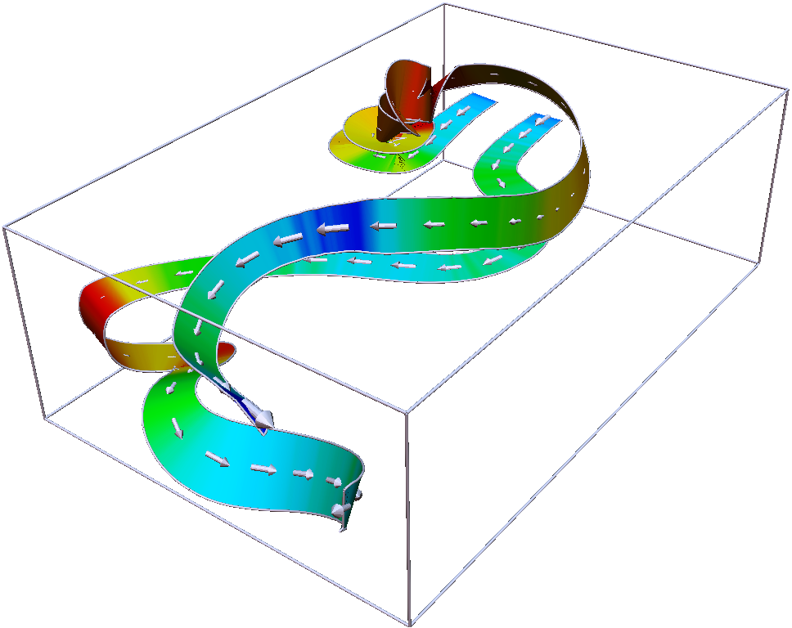
Stream Ribbons
Two
thick
Ribbons
Vorticity is color coded
Vector Glyth

Slide 44
Stream Ribbons
A stream ribbon is created by launching two stream lines from two seed points close to each other. The surface created by the lines of minimal length with endpoints on the two streamlines is called a stream ribbon
Notes:
Contour lines find the edge points, and use linear basis function to interpret the intra-cell pixels

Slide 45
Stream Surface
Given a seed curve Γ, a stream surface S_{Γ} is a surface that contains Γ and its streamlines
Everywhere tangent to the vector field
Flow can not cross the surface
Stream tube is a particular case of a stream surface: the seed curve is a small closed curve
Stream ribbon is also a particular case of a stream surface: the seed curve is a short line
Notes:
Talk about isoline and isosurface

Slide 46
Texture-Based Vector Vis.
Discrete or sparse visualizations can not convey information about every point of a given dataset domain
Similar to color plots, texture-based vector visualization is a dense representation
The vector field (direction and magnitude) is encoded by texture parameters, such as luminance, color, graininess, and pattern structure
Notes:
Talk about isoline and isosurface

Slide 47
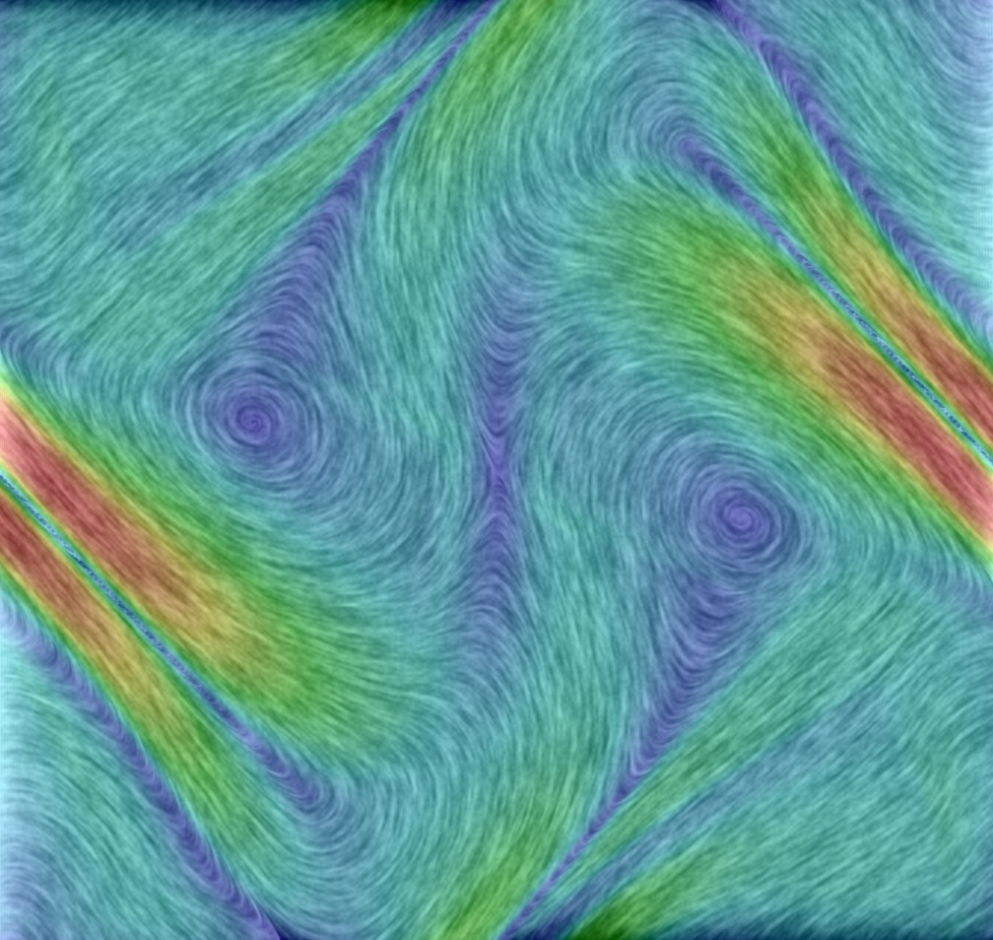
Texture-Based Vector Vis.
Vector magnitude:
Color
Vector direction:
Graininess

Slide 48
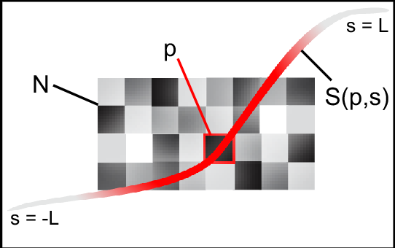
Texture-Based Vector Vis.
LIC principle: Line Integrated Convolution Principle
Notes:
N: noise texture
S(p,s): the streamline of seed point P

Slide 49
Texture-Based Vector Vis.
LIC is a process of blurring or filtering the texture (noise) image along the streamlines
Due to blurring, the pixels along a streamline are getting smoothed; the graininess of texture is gone
However, between neighboring streamlines, the graininess of texture is preserved, showing contrast.
Notes:
Talk about isoline and isosurface

